Slide 1
.
Lung Cancer Awareness
July 2015
Children and Families Network

Slide 2
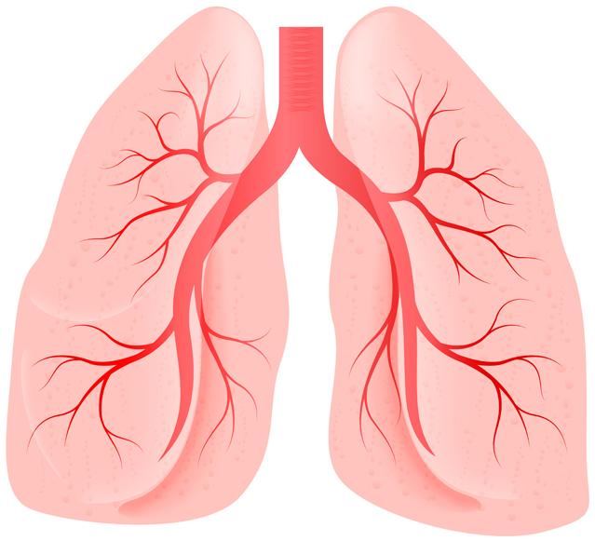
Children and Families Network

Slide 3
L
ve
Your Lungs
Children and Families Network

Slide 4
Lung Cancer is the 2nd most common cancer in the UK
CRUK 2011
Children and Families Network

Slide 5
It is more likely to occur in people aged over 60
CRUK 2011
Children and Families Network

Slide 6
86% of lung cancers are linked to smoking
CRUK 2011
Children and Families Network

Slide 7
14% of lung cancers are not linked to tobacco smoke CRUK 2011
Children and Families Network

Slide 8
Survival is more
likely if Lung Cancer
is diagnosed early
Children and Families Network

Slide 9
Occupational exposure to cancer causing agents is a risk factor
Children and Families Network

Slide 10
Family history
and low intake of fruit & veg are risk factors CRUK 2011
Children and Families Network

Slide 11
2 out of 3 cases are diagnosed at a late stage
Children and Families Network

Slide 12
Visit the GP Early
Been coughing for 3 weeks? Tell your doctor.
People can put off getting symptoms checked out for lots of reasons. They may have stopped noticing a cough or they may tell family and friends first.
Children and Families Network

Slide 13
Talk about signs and symptoms
Encourage people
to visit their GP
with any symptoms. It may not be cancer but, if it is, it’s better to find it early
Children and Families Network

Slide 14
Symptoms of Lung Cancer
Aggravating cough – (long standing or new that won’t clear up)
Coughing up blood
Shortness of breath or more out of breath than usual
Chest infections that do not get better
Ache or sharp pain when you cough or breathe in
Loss of voice or hoarseness without a sore throat
Unexplained weight loss
Feeling more tired than usual
Best to speak to your GP
Children and Families Network

Slide 15
For more information…
www.nhs.uk/livewell/Pages/Livewellhb.aspx
www.nhs.uk
www.macmillan.org.uk
www.cancerresearchuk.org/
http://www.wcrf-uk.org/
Or call;
Cancer Research UK Helpline 08088 004040
Communities Against Cancer Team 01254 358026
Children and Families Network

Slide 16
Reduce your lung cancer risk
Quit Smoking
Keep active
Try to eat at least 5 portions of fruit and veg a day
For free help and support to stop smoking contact the NHS Quitsquad
01772 644474 (Central Lancashire)
01254 283370 (East Lancashire)
Freephone: 0800 328 629
www.quitsquad.nhs.uk
Children and Families Network

