Slide 1
Maximising Advanced Services workshop & AGM
14th Sept 2017

Slide 2
Agenda
7.30 pm Welcome
7.35pm CPL Annual General Meeting
7.45pm MURs – Kevin Lu Whitworths Pharmacy
7.55 pm NMS – Mark Oak Broadway Pharmacy
8.05pm NHS Flu – Lloyds Pharmacy Team Thornton Health Centre
8.25pm NUMSAS – Linda Bracewell Baxenden Pharmacy
8.35pm HLP – Rowlands Pharmacy Team Euxton
8.45pm Review of what you have just heard
8.55pm Fin McCaul – PSNC update
9.00pm The GP Contract & working together to improve outcomes – Jenny Russell & Catherine Caine Eli Lilly and Company
9.30pm CLOSE

Slide 3
Delivery of the Vision
Workforce development - developing our Pharmacy teams to deliver a wide range of services to our patients
Leadership - leading community pharmacy through the healthcare reforms & beyond
Advocacy - championing the integration of the community pharmacy team into different patient care pathways to deliver seamless care
Innovation - leading the way for innovation, support & sharing of best practice
Accessibility - patients choose community pharmacy as the first port of call for health & lifestyle improvements

Slide 4
Table Work
How are you going to implement some of these top tips/ practices that you have heard tonight into your daily practice?

Slide 5
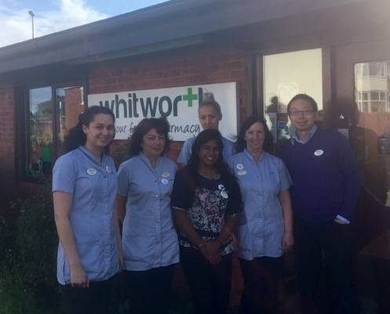

Slide 6
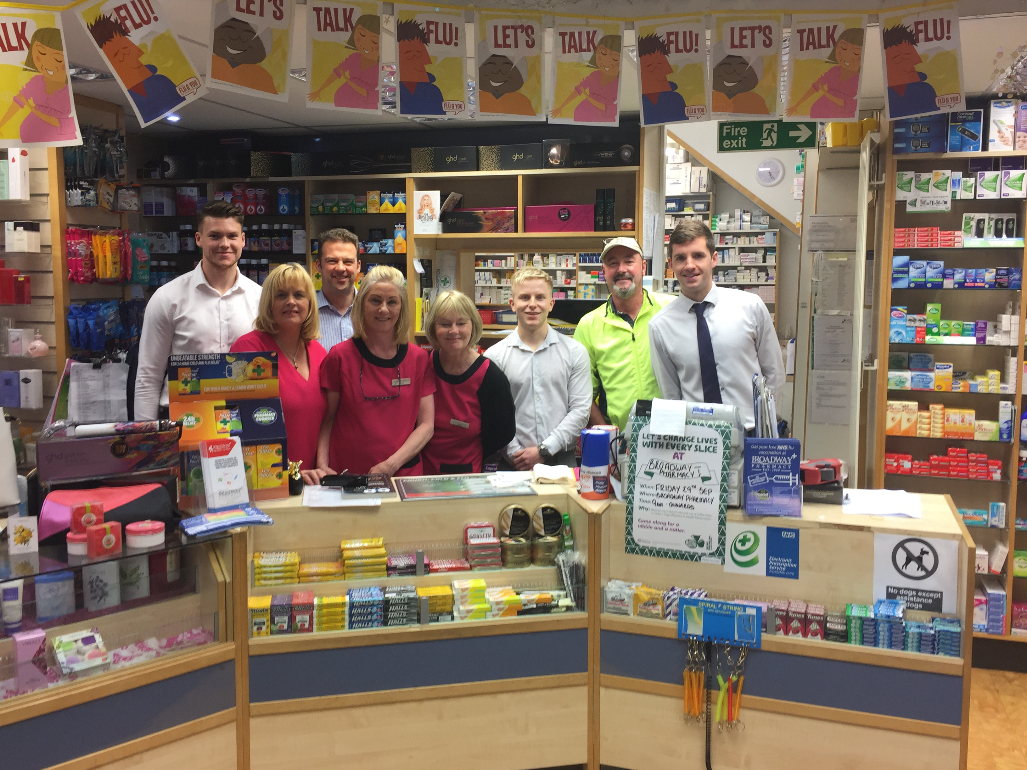

Slide 7
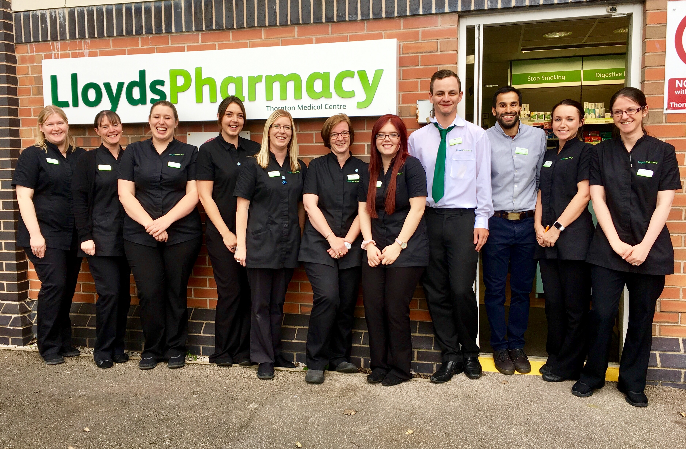

Slide 8
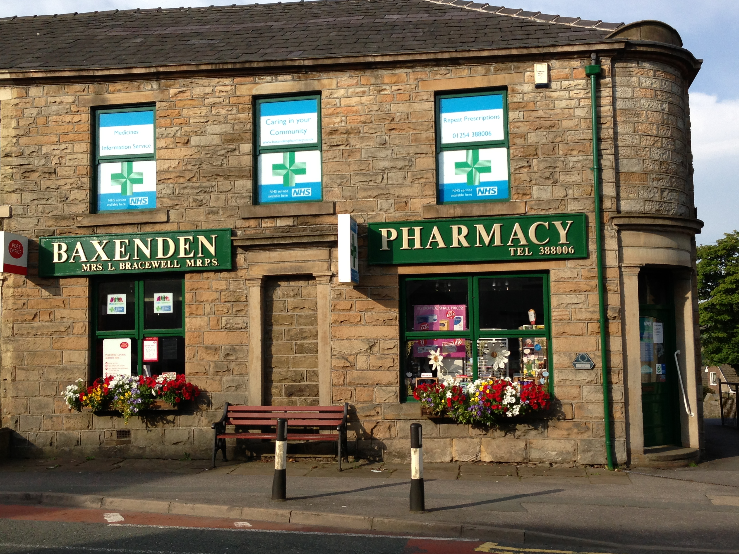

Slide 9
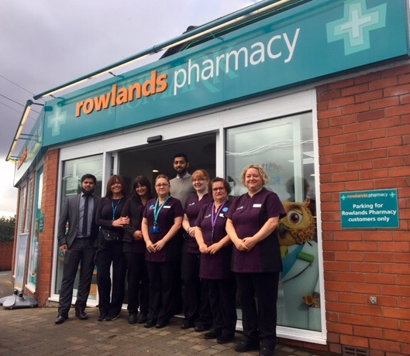

Slide 10
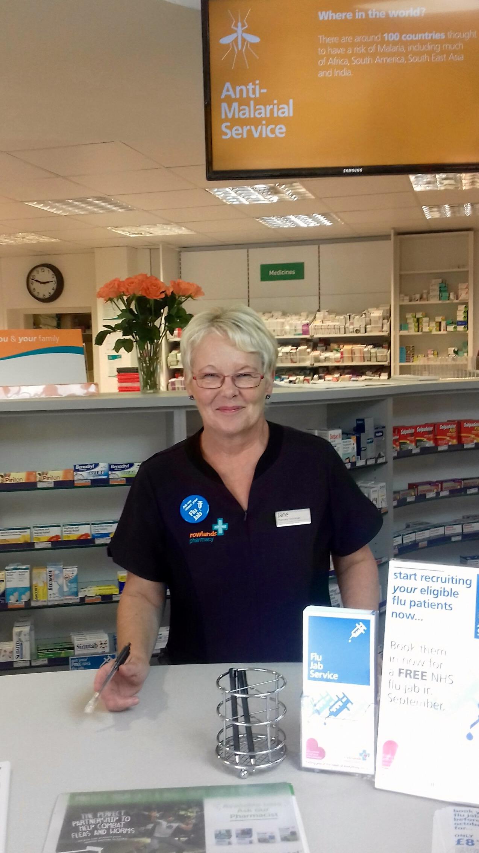

Slide 11
Table Work
How are you going to implement some of these top tips/ practices that you have heard tonight into your daily practice?

